Slide 1
Insurance Claim Amount Prediction
Abhijeet Sanjay Rathod(2023aiml553@wilp.bits-pilani.ac.in)
Anurag Mittal(2023aiml559@wilp.bits-pilani.ac.in)
Nitesh Kalwani(2023aiml568@wilp.bits-pilani.ac.in)
Shreenath Omar(2023aiml554@wilp.bits-pilani.ac.in)

Slide 2
PGP in Artificial Intelligence and Machine Learning

Slide 3
Agenda
Problem Statement
Literature Survey
Project Prerequisites, Challenges and Mitigation
Plan of Work
Solution Workflow
Preprocessing Steps, Modeling and Techniques applied
Model Evaluation
Fast API
Code Walkthrough and Execution
Future Work and Extension…

Slide 4
Problem Statement
Can AIML predict vehicle insurance outcomes?
  Predicting insurance results with high accuracy can help insurers (insurance companies) make more informed decisions, reduce risks, and improve customer service.
  By leveraging machine learning, the solution enhances efficiency and enables faster, more reliable claims assessments/settlements.
  Develop supervised ensemble learners to optimize asset insurance processes by providing data-driven insights into potential outcomes.
Conventional Approach for insurance claim amount prediction
  Manual analysis of claim amount prediction based on the data provided in insurance claim form and user attributes
Insurance Industry Challenges
  Dependency on multiple parameters for determining the amount for claim settlement
  Customized claim plans for customers based on customer attributes
  Risk of errors due to manual approach for claim amount settlement

Slide 5
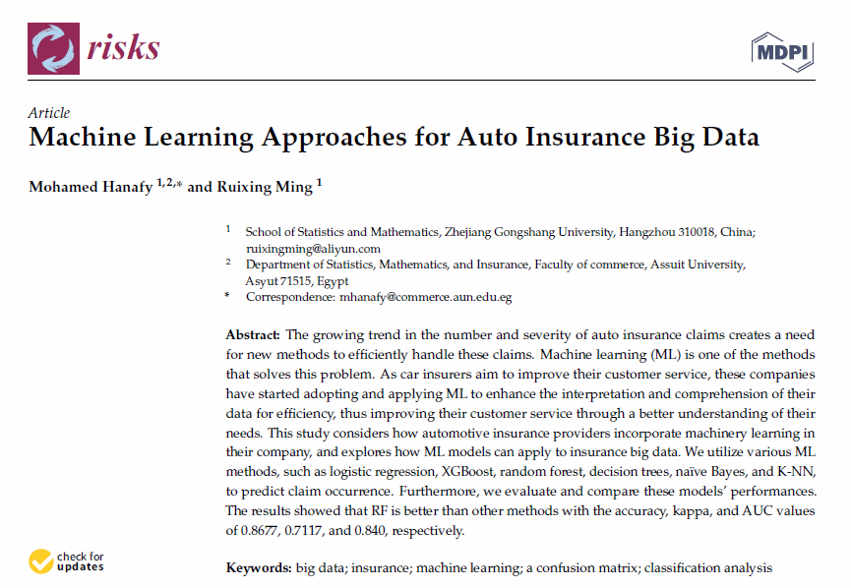
Literature Survey
Machine Learning Approaches for Auto Insurance Big Data- Mohamed Hanafy 1,2,* and Ruixing Ming 1 - School of Statistics and Mathematics, Zhejiang Gongshang University, Hangzhou 310018, China; ruixingming@aliyun.com
Notes:
Several factors determine automotive insurance quotes1. These factors can establish how much a driver will pay for their insurance contract. A common example of these factors is credit history.
Drivers' specific attributes like location, driver history plays a crucial role in determining the claim settlement amount
ML model should show which clients are unlikely to make claims, decrease their insurance cost, and raise the insurance cost for those who are likely to make a claim.
In this study, we investigate more powerful ML techniques to make an accurate prediction for claims occurrence by analyzing the big dataset given by Porto Seguro, a large automotive company based in Brazil3, and we apply the ML methods in the dataset, such as logistic regression, XGBoost, random forest, decision trees, naïve Bayes, and K-NN. We also evaluate and compare the performance of these models

Slide 6
Proposed ML Solution
How ML can improve claim predictions
  The proposed ML solution provides a data-driven approach to accurately predict insurance claim amounts, improving efficiency, fraud detection, and customer satisfaction.
Overview of the ML pipeline:
  Data Collection & Data Preprocessing
    Gather policyholder data, insurance details, vehicle details
    Data Preprocessing, Data Transformation and Data Creation
  Feature Engineering
    Transform raw data by performing Feature engineering techniques like Identifying relevant Features, Feature scaling ,Feature creation
  Model Selection & Training
    Train ML models for claim prediction (Regression-based)
    Use LLM to justify predicted claim values
    Explainable AI approach for transparency
  Evaluation & Deployment
    Assess model accuracy, fine-tune hyperparameters, and deploy it for real-time predictions and integrate with LLM to justify the predicted claim amount

Slide 7
Project Prerequisite, Challenges and Mitigation
Generating Sample Dataset
  Multiple data attributes were extracted from the insurance policy form and the claim form.
  Provided all the data values input to Python Faker library .
  The Python Faker library was used to generate a randomized sample of 5,000 data entries based on correlation rules between numeric attributes.
Handling large number of attributes
Model Section and Implementation
  Despite 10 days of dedicated effort with Hugging Face model , faced compatibility issues and couldn't be implemented.
  Alternative models like XGBoost and deep neural networks performed better.
Fast API implementation
  Lack of prior experience with Fast API
  Also lacked development experience, which led to challenges during Fast API implementation.

Slide 8
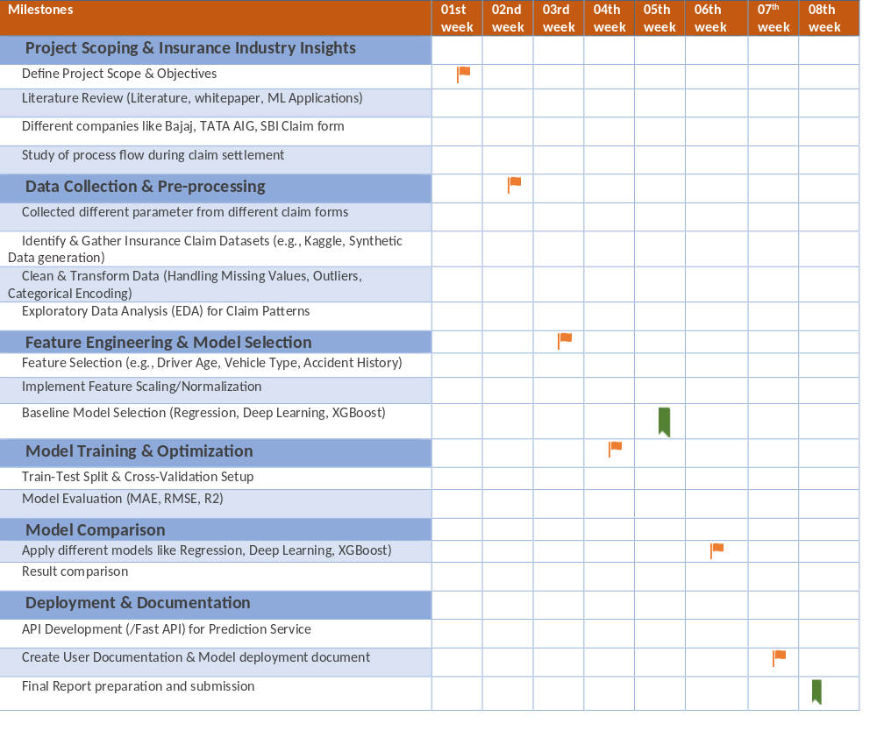
Plan of Work
Weekly checkpoint with mentor
Review and viva with faculty

Slide 9
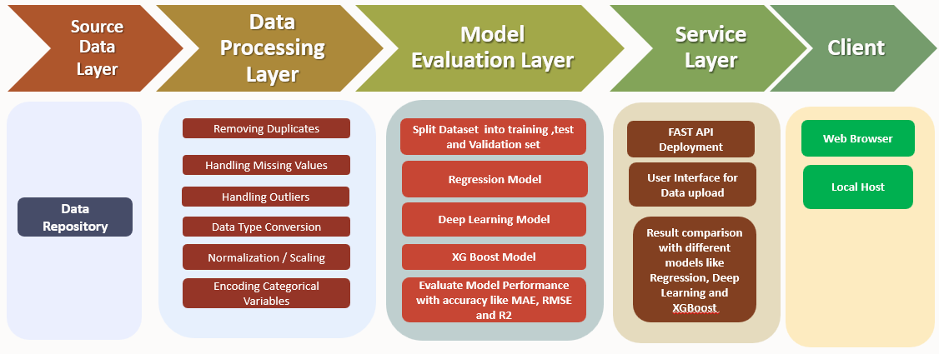
Solution Workflow

Slide 10
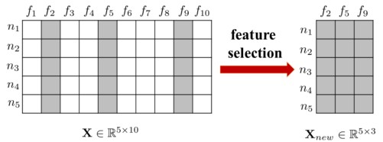
Pre-Processing Steps
Following Feature Engineering techniques have been used for EDA on the the given insurance claim dataset:
Feature Selection
  67 features were selected from total 115 attributes in the given dataset based on their relevance and correlation with the target attribute i.e. insurance amount prediction
  Pearson Correlation analysis used to analyze the correlation between target output (i.e. claim amount) and independent attributes
Feature Transformation
  Used vector embedding to transform categorical attributes to numeric attributes
  Label encoding using embedding layers
Feature Creation
  A new attribute was created using the insurance validity attribute, to capture the number of days left till the expiry of an ongoing claim
Various other data preprocessing techniques were used to analyze the dataset for any inconsistencies – missing data, duplicate records, box plot analysis for outlier detection

Slide 11
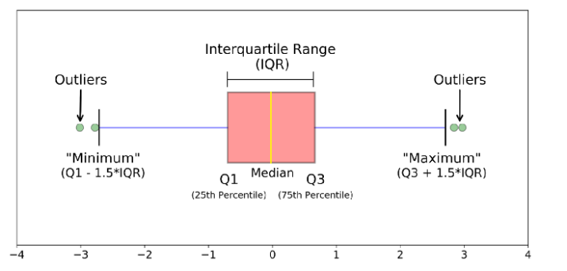
Measuring the Dispersion of Data
BOX Plot Analysis
Quartiles/Percentiles – Three data points that split the data distribution into four equal parts
  Each part represents 1/4th of the data distribution
  Q1 – 25th Quartile and Q3 – 75th Quartile
Five-number summary of a distribution
  [Minimum, Q1, Median, Q3, Maximum]
Boxplot Analysis
  Data is represented with a box
  The ends of the box are at the first and third quartiles, i.e., the height of the box is IQR
  The median is marked by a line within the box
  Whiskers: two lines outside the box extended to Minimum and Maximum
  Outliers: points beyond a specified outlier threshold, plotted individually
DATA DISPERSION METRICS
Range (max – min)
Quartiles (Q) and Inter-Quartile range (IQR)
Five-number Summary and boxplots
Variance (σ²) and standard deviation (σ)

Slide 12
Modeling Techniques
Linear Regression (Baseline Approach)
  Linear regression estimates the relationship between one or more independent variables (predictors) and a dependent variable (outcome).
  Target attribute – claim_amount
  Independent attributes – Selected a subset numeric and categorical attributes (insured_amount, premium_amount, policy status, repair estimates, etc.)
  Advantages
    Simplicity: Easy to implement and understand.
    Interpretability: Provides clear insights into how each predictor influences the claim amount.
    Efficiency: Computationally less intensive, suitable for large datasets.
  Limitations
    Linearity Assumption: May not capture complex, non-linear relationships in data.
    Sensitivity to Outliers: Outliers can disproportionately affect model performance.
    Multicollinearity: High correlation among predictors can lead to unreliable estimates.

Slide 13
Modeling Techniques
XGBoost (Extreme Gradient Boosting)
  Advanced ensemble learning algorithm based on decision trees, optimized for performance and speed
  XGBoost learns patterns by sequentially building decision trees where each new tree corrects the errors of the previous ones
  For predicting insurance claims, the model efficiently captures both linear and non-linear relationships among features such as vehicle type, driver history, policy details, and claim frequency.
  XGBoost builds an ensemble of regression trees in a stage-wise manner, optimizing an objective function that combines prediction loss (e.g., squared error) and regularization
  Advantages
    Delivers high predictive accuracy, often outperforming traditional regression models.
    Fast training due to optimized gradient boosting and parallel computation.
    Captures non-linearities and intricate feature relationships without explicit feature engineering.
    Handles missing data internally without requiring imputation.

Slide 14
Modeling Techniques
Deep Learning (CNN)
  Convolutional Neural Networks (CNNs) are a class of deep learning models that mimic the human brain's structure to learn complex patterns in data
  A typical CNN consists of an input layer, one or more hidden layers with multiple neurons, and an output layer. Each neuron applies a weighted sum of inputs followed by an activation function. This layered architecture enables the model to learn intricate feature interactions that traditional models like linear regression might miss
  Advantages
    Capable of modelling complex, non-linear relationships in insurance data.
    Automatically learns and combines relevant features without manual engineering.
    Performs well with large datasets and high-dimensional input features.
  Limitations
    Requires more resources and time for training, especially with deeper networks.
    If not properly regularized, the model can overfit, especially on small datasets.

Slide 15
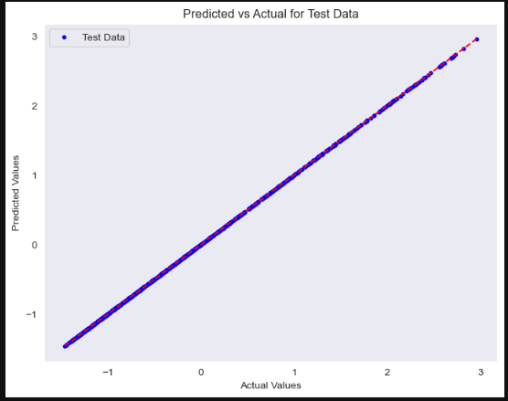
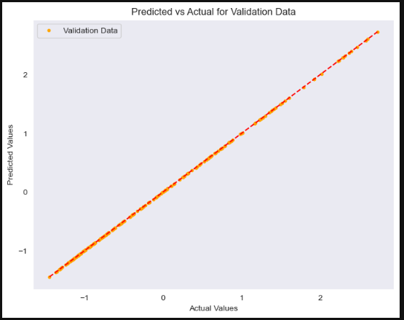
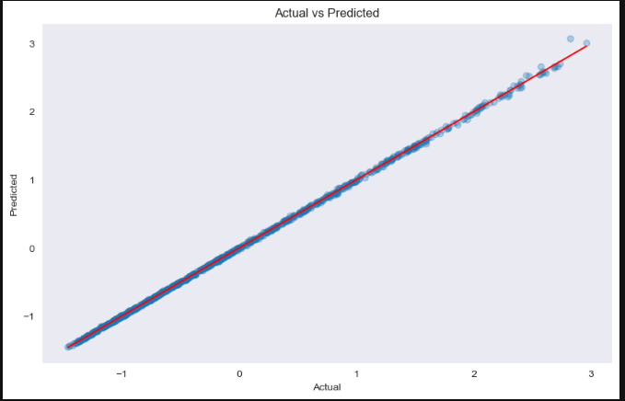
Model Evaluation
Model | MSE | R2 | Accuracy %
Linear Regression | 1.6503733556431242e-25 | 1 | 99.99
Deep Leaning | 0.000412 | 0.99 | 68.58
XGBoost | 0.000274 | 1 | 99.93
Linear Regression
Deep Learning
XGBoost

Slide 16
Code Walkthrough

Slide 17
Fast API
Overview
  Developed a RESTful API using FastAPI to expose the trained ML model.
  Accepts CSV file upload as an input for batch prediction of claim amount.
Architecture
  Input:
    CSV file with customer & policy attributes
  API Endpoint:
    /predict/csv
  Processing:
    Input validation using Pydantic
    Model prediction (loaded via Joblib)
  Output:
    Predicted Claim Amount (JSON)
    Technical Stack:
  FastAPI & Uvicorn
  Pandas, Scikit-learn, XGBoost, TensorFlow/Keras (CNN)

Slide 18
Future Work
💡 Integration of Real-World Data
Collaborate with insurers to validate and fine-tune models using anonymized, real-world claim datasets.
🧠 Adoption of Advanced Deep Learning Architectures
Explore Hugging Face Transformers and LLMs for text-based claims and justifications.
📊 Enhanced Feature Engineering
Incorporate external data such as weather, traffic patterns, and geolocation-based risk indicators.
🛡️ Improved Usability
Integrate various pre-processing tasks in Fast API implementation
🔁 MLOps & Continuous Learning
Set up pipelines for automated retraining and monitoring to keep models updated with new data.
📈 Explainability & Transparency
Use tools like SHAP or LIME to explain model predictions, especially for regulatory compliance.

Slide 19
References
Machine Learning in Forecasting Motor Insurance Claims: https://www.mdpi.com/2227-9091/11/9/164
Machine Learning Approaches for Auto Insurance Big Data: https://www.mdpi.com/2227-9091/9/2/42
Insurance Claim Prediction - https://www.kaggle.com/code/yasserh/insurance-claim-prediction-top-ml-models
https://www.youtube.com/watch?v=wFUMqh5JePA
https://ieeexplore.ieee.org/document/10724028/
FastAPI - https://fastapi.tiangolo.com/
SBI General Insurance Company – Motor insurance claim form: https://content.sbigeneral.in/uploads/1f5a3fb5cb654110afe7a7d505dffcce.pdf
Deloitte - The Age of With™ Accelerating the impact of augmented intelligence in insurance- https://www2.deloitte.com/content/dam/Deloitte/ca/Documents/deloitte-analytics/ca-en-age-of-with-insurance-aoda.pdfs

Slide 20
Thank You!

Slide 21
Dataset Generation
Multiple data attributes were extracted from the insurance policy form and the claim form.
  Motor Trade Package Policy Form https://www.tataaig.com/s3/Proposal_Forms_auto_secure_private_car_package_policy.pdf_609fa9466f.pdf
  Auto Secure Claim Form https://www.tataaig.com/s3/R3_Auto_Secure_Claim_Form_cdf0776d75.pdf
Worked on all the possible values for different categorical columns.
Provided all the data values input to Python Faker library .
The Python Faker library was used to generate a randomized sample of 5,000 data entries based on correlation rules between numeric attributes.

